Slide 1
Digital Image Processing
Lecture 2: Introduction

Slide 2
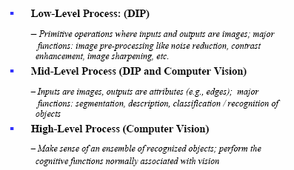
Classification of DIP and Computer Vision Processes

Slide 3
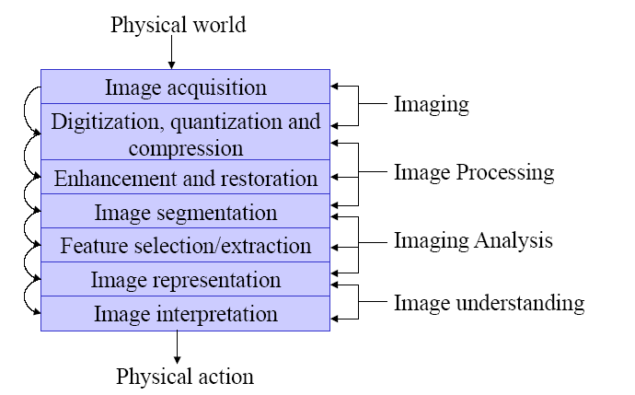
Image Processing Steps

Slide 4
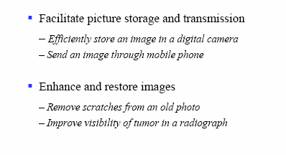
Why do we Process Images?

Slide 5
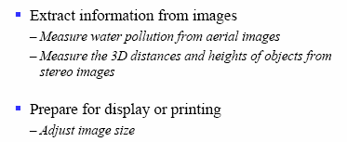
Why do we Process Images?

Slide 6
Video sequence processing
To detect moving objects in image sequence for further processing
  Some applications are
    Detection and tracking of moving targets for security surveillance
    Finding the trajectory of moving targets
    Monitoring the movements of organ boundaries in medical applications

Slide 7
Image Formats
Compression
  An image contains redundant information which can be exploited for achieving compression
  Three types of redundancy
    The first kind of redundancy is called a pixel redundancy
    The second kind of redundancy is called a coding redundancy
    Third kind of redundancy is called a psycho visual redundancy.

Slide 8
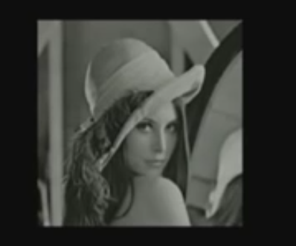
Pixel redundancy

Slide 9
Applications
Storage space reduction
Bandwidth reduction

Slide 10
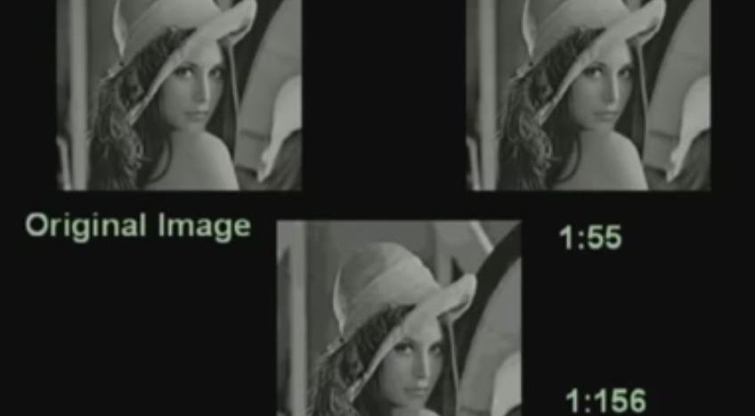
Compression

Slide 11
Lossy compression
Remove redundancy as will as also remove some of the information so that after removing those information, the quality of the reconstructed image is still acceptable
There will be some loss or some distortion and this is taken care by what is called rate distortion theorem.

Slide 12
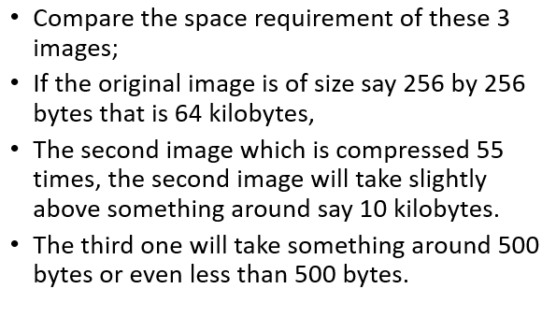
Compare the space according to compression

Slide 13
DIP Related Projects
Remote Surgery
Adult Filtration
Watermarking
Visible
Invisible
Gender Classification
Facial Expression Classification
Video Processing
Segmentation
Watermarking
Object Tracking
Driver Fatigue Detection

